Slide 1
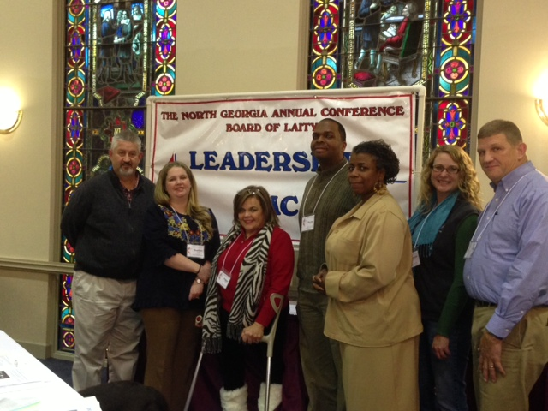
Vital Churches Have More Programs for Youth:
The Wesley Gang
Kevin Bell, Heather Breeden, Tim Galloway,
Heath Jones, Marianne Shockley,
Shelia Taylor, Peggye Thornburg, Debie Marshall
Notes:
Hi, I'm Tim Galloway, and we are the Wesley Gang. Our focus area as a part of the Vital Congregations initiative is, Vital Churches Have More Programs for Youth More programs for youth? Not necessarily more programs for youth just to keep them busy, but to engage them in the life of the church, and help build their faith for a lifelong journey as disciples of Jesus Christ.
Youth…..That’s a subject that can cause churches feelings of joy, inspiration, comfort, but also confusion, annoyance, nuisance, and misunderstanding. How about the youth in your church? Are they… noisy, a distraction, a problem, missing? Or… does your church have a active, uplifting, vibrant and engaging youth program? There is a vast amount of resources and support available in the conference and in the denomination to help local churches connect with the youth in their church and their communities, and to engage them in building their faith foundations.
Challenges of youth programs. Middle school and high school age teens are socially aware and connected, technologically savvy, active in sports, clubs, community, and hopefully the church. As worldly and connected as today's youth are, most are, when given the opportunity, are also deeply spiritual. Youth that have the opportunity to explore their faith in a safe environment, ask hard questions and have the opportunity to connect with the whole church, in worship, prayer, study, and service are more likely to sustain that faith journey on in to adulthood. One of our guiding verses in our project has been a passage from 1st Timothy……... 1 Timothy 4:11-12 11 These things command and teach. 12 Let no one despise your youth, but be an example to the believers in word, in conduct, in love, in spirit,[b] in faith, and in purity. Let no one despise your youth…. Paul felt that even though Timothy was young, he had the qualities to be a leader and an example of faith and love to other believers, and we believe our youth have that potential also.
Conclusion With our presentation today, our group hopes to bring you ideas and resources that will help your church deliver a active and engaging program for your youth. Now, ……….. will bring us information how…..

Slide 2
Everyone Can Make a Difference, No Matter How Young You Are
Making Church A Relevant and Meaningful Experience for Our Youth, Encouraging Discipleship & Transformation of the World
Notes:
Everyone God created, He purposed. There absolutely God can’t use for His kingdom. Experience is a good teacher, but experiencing God is the supreme instructor! Remember, God called Samuel when he was a youth in the temple – He called David, a shepherd boy from the pasture to defeat the mighty Goliath… with a slingshot!!
Our goal is to create an atmosphere for our youth to experience God in a way that THEY can understand… fostering a zeal for God that they can not contain and empowering them to be the Samuels and Davids – presently and in the future.

Slide 3
Mission Statement
3 Levels of Youth Engagement
Love God (Worship)
Love People
(Teaching & Learning)
Serve the World
(Mission)
To meet youth where they are and invite them into the love of Christ by engaging them through love and service.
Notes:
Too often today, we (adults) tend to make our youth feel like second class citizens. It seems as if we’ve forgotten what it was like to be young, to find ourselves, to dream dreams. Remember, we saw a new world… a new rhythm, a new look! And look at us now!... We are becoming the leaders of that tomorrow right now! We need to affirm the individuality, look and feel of the personal relationship with God in our youth. They will also do great things for God – it is our responsibility to HELP them on this journey.

Slide 4
Love God
Worship
  Weekly worship together
  Visual arts, tech, music
  Move youth to front for a season
Hospitality/Fellowship
  Greeting ministry
  Website
  Childcare
Service/Outreach
  Mission trips with adults
  Kitchen/meals
  Congregational care, prayer team
Discipleship
  Find Mentors
  Prayer partners
  Pen pals
“If the youth believe that the only reason you have built a relationship with them is to get them to come to church, then you have lost the impact of the relationship.”
-Sam Halverson, Associate Director of Connectional Ministries for Youth and Young Adult Ministries, North Georgia Conference of UMC
Notes:
The first area of youth engagement is Loving God or teaching youth how to worship. Sam Halverson is the Associate Director of Connectional Ministries for Youth and Young Adult Ministries with the North Georgia Conference and an invaluable resource for congregations who are looking for direction and ideas in developing their youth programs. Sam presents a seminar called Siloed ministries and how they effect the church. He defines a siloed ministry as any ministry that doesn’t include others from the congregation in its focus. Many of his ideas stem from a study that was conducted by the Fuller Seminary in California. The summary of this research is called “Sticky Faith.” Sticky Faith refers to a faith that “sticks” with someone for life. The purpose of the research was to discover the factors that most contributed to youth who continued to be active in a church as young adults. The two major findings of this research was: 1) youth that were ONLY involved in a youth ministry were far less likely to be involved in a church as young adults and 2) the single, most influential factor in long term engagement in church for young adults was their participation in corporate worship as a youth.
How do we get into silos?
-Separating youth from congregational worship
-Hiring someone to be in relationship with your youth. The youth pastors job should be helping to build relationships between the youth and the congregation.
-Limiting volunteer pool to parents of youth
-Using ONLY college students or young adults to work with the youth
How do we get out of solos?
Worship: work towards worshipping together weekly and have the youth participate in some part of the worship service
Hospitality: greeting ministry, website, childcare
Service/Outreach: mission trips with the adults, congregational care, prayer team
Discipleship: Find mentors, prayer partners, pen pals
At the end of this presentation there will be several websites listed that you can visit to learn more about these ideas and others to encourage growth in your youth program.

Slide 5
Love People
Development of effective and meaningful programs in teaching and leaning.
Integration of technology as a tool to make learning about God and His mission for our lives exciting and fun is essential.
Incorporating tools in methodologies that the youth can use to show love everywhere.
John 15:12
My command is this: Love each other as I have loved you.
Seek them
Include them
Supply them
Use them
Notes:
We must seek the out the youth. We have to go where they are, see what they see, hear what they hear and communicate how they communicate. We need to stop criticizing them for how they express themselves – remember, we were different in our parent’s eyes… We have to let them know that we accept them as they are and they are not only a part of God’s family, but they are a part of our family - the church family!
We must nurture a genuine, caring, loving relationship with the youth – just as we nurture our relationship with God. We must invest time in their development. We must show our inclusiveness by allowing and encouraging them to participate in congregational activities – not just relegate them to youth specific activities.
Of course we need faith building activities targeted for them – we as adults need age specific activities also, but we also need to have joint faith building activities with the youth. We need to foster the communal love of God and His love for us in their hearts.
We must live what we teach. To make our youth disciples of Jesus Christ, we need to educate them (build a biblical foundation), demonstrate to them (show our love through our interactions with our church members as well as those outside of the church) and allow them to participate in discipleship (by inspiring them to show the same love to each other as well as non-church members just because they are children of God). We teach our youth how to show love by living out God’s command.
There are a myriad of tools we can use to accomplish this goal:
* Integrating technology as a tool to make learning about God and His mission for our lives exciting and fun
* Using technological programs and applications that the youth are using today which will work well with teaching God’s word
* Using the internet for online Sunday School quizzes
* Making study tools using digital presentations
* Using Social Media to stay abreast of activities and programs
* Scheduling youth developed regular monthly events
* Having small groups
* Participating in youth milestones such as confirmation service
Incorporating these tools in the teaching and learning process puts a new twist on learning who God is, what God does, how God loves us and what His plan is for us. We as disciples are called to share that with the world!!

Slide 6
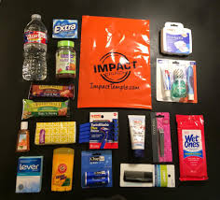
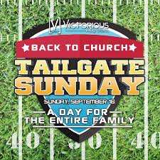

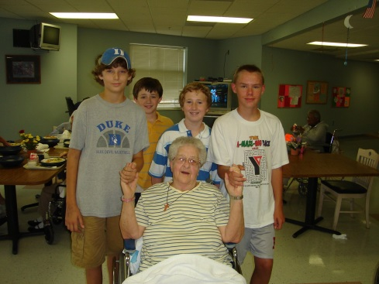
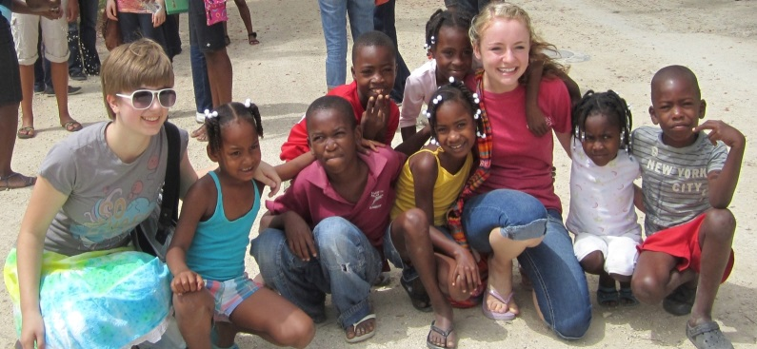
Serve the World
Vacation Bible School
Love Kits
Drama/Music Camps (with disciple graduation)
Tailgates
Operation Christmas Child
Easter Egg Hunt
Christmas Party
Stop Hunger Now
Food Pantry
Community Service visits
Visit Shut Ins
Mission Trips
Global/local
94 Community Servant Evangelism Ideas
Mission and outreach
Many times our youth reach out to the public in acts of service and kindnesses that makes a lasting impression on the community as a whole.
True heartfelt service for those in need is what it is like to be in the image of God.
Notes:
94 Community Servant Evangelism Ideas for Your Church
Steve Sjogren ServeCoach.com
Servant Evangelism (SE) connects people to people in a natural, easy, low risk, high grace way. Who doesn't like to be given a cold soda on a hot day? Especially by someone who is smiling, happy and having fun. SE wins the heart before it confronts the mind. A small act of kindness nudges a person closer to God, often in a profound way as it bypasses ones mental defenses. The average Christ-follower is willing to hand a stranger a can of soda (low- risk). The high grace is seen in the typical reaction. “Oh, thank you!” “This is so nice!” “I can’t believe this is for free!” And, “Why are you doing this?”
Kindness builds the bridge for the person to receive a touch of love from God. Add an invitation to church or other method of connection—even a simple card with your church's name, phone number and times of services—and you’ve reached someone with the love of Christ! It’s simple, practical, effective, inexpensive and fun! We get reports from pastors, lay leaders and ordinary Christ-followers all over the world who have discovered the power and impact of “showing God’s love in practical ways,” and again and again we’ve seen relationships with God born from these simple acts of kindness in Christ’s name.
Here are some great ideas to get your church started in servant evangelism.
EASY, LOW-COST GIVEAWAYS
Coffee Giveaways
Use either Igloo containers or air pump thermoses. Offer three options: regular, decaf and hot chocolate. On a cool day, you will have folks swarming for a cup of something hot. You will need three or four people to help give away coffee for each big canister. With each drink, we give out a connection card. Consider having paper cups with your church’s name and logo printed.
Newspapers
Some convenience stores will allow you to purchase an entire stack of newspapers. Place a sign on the top of the stack that reads, "Free Newspapers – Courtesy of (Church Name)" and attach a connection card to each paper with removable adhesive.
Donut Giveaway during Morning Traffic Times
This giveaway is especially effective when performed by senior citizens— who can say no to a sweet grandma-type? These gals set up on a traffic island at a stoplight (make sure they’re safe out there). When the light turns red, they step up to cars and ask, "Would you like chocolate, maple or glazed?" They then give them a connection card with the snack.
Soft Drink Giveaways
"Hi, would you like regular or diet?" This is our standard opening to bless folks with a small act of kindness on a hot day. And it works! We set up at grocery store entrances with large coolers filled with ice and drinks. Buy name-brand drinks instead of the cheaper stuff, and place a connection card under the opener. A courtesy note: Sometimes a location will conflict with vendors selling what you are giving away. Some of the most irate critics we've run into have been vendors who conclude we are trying to put them out of business. The answer: Set up in a location away from vendors. In extreme cases, consider asking the vendor how much money he/she anticipates losing by our presence, then give them that amount in cash.
Bottled Water Giveaway
Many people prefer water to soft drinks. Ice down bottles of water in large coolers for an alternative to a soft drink giveaway. Use the same connection cards. We don't recommend combining this with a soda giveaway, because it offers too many options and gets complicated.
LifeSavers
If you are looking for an affordable entry point for a large number of people, consider this one. We purchase the candy at a warehouse store for about five cents per roll. We attach a connection card and give out hundreds of these candies to passersby. Everyone will take a roll of these candies. Consider printing the message of the connection card onto mailing labels and sticking them over the top of the LifeSavers wrapper.
Lollipops / Blowpops
These are great giveaway items for parks, festivals, and college campuses. Purchase at a warehouse store for around six cents apiece, and fold a mailing label with connection information around the stick.
Popcorn
You can either make bags of popcorn before you arrive at your outreach site, or consider renting/purchasing your own carnival style popping machine and do it on the spot. You will draw more of a crowd with the machine on hand.
Sunglasses (cheap ones!)
Have you ever left home for a sporting event only to forget your sunglasses? Many sporting events attendees experience this every weekend. We have purchased large quantities of sunglasses for as little as a quarter a pair.
Ice Cream Coupons
Approach a local ice cream store and explain your desire to give away thousands of ice cream coupons. Chances are the owner/manager will be willing to give you a good deal on ice cream coupons. Attach a connection card to each coupon, and you'll have a project that will elicit a response from just about everyone in town.
SERVICES
Umbrella Escorts
Moms with kids and the elderly find it tough to make it from stores to their cars in the rain. We use huge golf umbrellas to help get them and their purchases to their cars with as little wetness as possible.
Grocery Bag Loading Assistance
Moms with lots of kids hanging on them like koalas often need assistance getting their bags loaded into the car from the shopping cart. The elderly need the same sort of help. Volunteers on this project need to appear particularly safe and friendly; name tags or coordinating T-shirts identifying connection to your organization makes the servants look more “official.” Note: On this project, almost everyone will try to give a tip, but as with all kindness projects, to receive money would taint what you are trying to communicate: "God’s love in a practical package with no strings attached." This project may require permission from the store manager on the day of the event.
Bag-Packing at Self-Serve Grocers
Increasing numbers of grocery stores are cutting out services such as
bag-packing. Place volunteers at these stores to pack bags for customers. Again, name tags or coordinating T-shirts or aprons helps the baggers look more official and identifies the connection with your organization.
The first time we volunteered to do this, the manager was skeptical, but the feeling quickly melted. We've received reports from all over the US that this project is very effective.
Trash Pick-Up
There is lots of trash to pick up at festivals and sports events. Buy garbage bags, wear matching T-shirts and plastic gloves, and bring a sign to put up that says, “Kindness in Progress” while you pick up trash. People will notice.
Shoe Shines
Small investment + some elbow grease = big return. Set up in front of a grocery store on a Saturday, or perhaps in front of a barbershop. This is a great project to get talking with people; you have a captive audience while you serve!
Restroom Cleaning at Public Places
This is Steve Sjogren's favorite project. There's nothing like walking into a gas station, restaurant, or retail store and saying to the manager, "We'd like to clean your toilet for free!" Put a little cleaning kit together containing a toilet brush, air freshener, window cleaner, paper towels, toilet bowl cleaner, rubber gloves, and a doorstop. There's nothing magical about the technique here. Steve has cleaned commodes all over the world, and says they are all pretty much the same as the ones in your home. Note: This is probably one of the most frequently rejected projects we do, probably because the offer to clean a toilet is a bit overwhelming. No matter—give them your connection card, smile, and say, “OK! We'll come back some other time and clean when you need it. We're just trying to show you God’s love in a practical way.”
AROUND TOWN
17.Business Blasts
Surprise employees of local businesses with a small gift, such as a basket of candy. Bring in one package to be shared by store employees and leave a connection card that reads something like, “We appreciate how you serve the community with your business, and we wanted to share God's love in a practical way.” Make sure you only give items to employees, so they don't think you are "soliciting" their customers.
Soft Drink Giveaway to Employees
What can you do when denied permission to give away soft drinks in front of a prime retail location? Offer to give soft drinks to the employees. As usual, place the connection card on top.
Stamps in Front of the Post Office
One church holds a major stamp outreach on April 15th for late tax-filers. Not only do they give out stamps, but they also offer coffee and donuts— stress recovery food. Volunteers stand by the mail drop-off boxes with a card table filled with food and stamps.
Gatorade at Biking Trails
Some health-conscious folks like runners, bikers, and other people don't drink soda at all. Set up at along a bike trail, athletic field, or hiking trail and offer Gatorade or bottled water to exercisers.
Pay Library Fines
Leave $20.00 at the front desk in the local library, and instruct the clerk to use it for the next person who has fines. Leave a connection card in an envelope for the person, so they can see why the fine was paid.
Surf Wax
Who says non-surfers can't relate to surfers? Buy the current popular brand of wax and hit the beach, dude! It's a definite door-, or rather board-, opener.
Pictionary in the Park
This was a popular game in the late 1980’s similar to Charades. Set up in a local park and play the game using with a white board to draw hints. Complete strangers will start to join in, especially if your group is friendly and animated. When onlookers correctly guess the answer, allow them to play the next round. After 15-20 minutes, take a break, serve soft drinks and talk to the visitors one-to-one.
Golf Balls
The average golfer loses three or four balls per outing, so give away imprinted golf balls on the local golf course. Imprinting your church’s name and message on golf balls is surprisingly affordable, and if it's lost on the course, another golfer will pick it up later and get your message.
Golf Tees
Golfers can never get enough of these. Imprinted golf tees cost just a couple of cents apiece. Some golf courses will even give them away for you at their counter.
Golf Ball Cleaning
Sure, there are ball-cleaning machines spread throughout most golf courses, but most players don't take the time. With permission of the course, set up a simple clean up station and clean golf balls before golfers begin a round. Most golfers carry dozens of balls in their bag.
Cleaning Up at Food Courts
If you can get your foot in the door at your local mall, ask if you can do clean-up in the food court area. Along with a connection card, consider distributing handy-wipes with your logo imprinted on them.
Upsizing Food Orders in Fast Food Drive-Thru Lanes
Set-up near the drive-thru order station. As customers drive up, offer to pay the difference between their order and the bigger size—which is usually about 39 cents. Your offer will get the entire restaurant talking.
Free Bird Feeders and Refills to Convalescent Home Residents
Provide an acrylic bird feeder—the kind with suction cups that stick right to the window. Return occasionally to refill the bird feeder and check in on your new elderly friend. Note: Most outreaches to those in convalescent homes will touch their extended family, as well.
Bait at Local Fishing Spots
Those who fish with live bait need worms, grubs, goldfish, minnows, or whatever. Purchase these critters in large quantities from a bait shop, go to the local fishing hot-spot and give them away. This brings new meaning to the verse from Psalm 51, "I am a worm and not a man."
Pay Laundromat Washer and Dryer
Bring a roll or two of quarters and dimes. As patrons enter, ask them if they'd like hot or cold wash. You can also provide detergent. Note: This is a project that works best for women—it's a bit odd for men to reach out to women in this setting.
Instant Photos for Couples
A couple will hold on to a decent photo of themselves for years. Set up at a local carriage ride or other common spot for couples and take instant- print photos of them. If you want to get fancy, offer a photo frame that is tailor-made for the size. Attach a sticker of your church’s logo and phone number on the back.
Hand Cleaning Towelettes
Pretty much everything in downtown shopping areas is a bit dirty, but there's really no place to wash up. Give people these towelettes labeled with your organization’s message.
Cart Token for Shopping Carts
Some grocery stores in urban areas require a token in order to get a shopping cart. Provide the tokens to shoppers as they enter.
Gasoline for Your Neighbor
How many people do you see buying less than a tank of gas when you fill ‘er up? We see it happening all the time—they can’t afford a full tank of gas at today’s prices. Add $5.00 to their total and blow their minds. Of course, add in a connection card.
Steaks and Salmon for Firefighters
Since 9/11, the general public has been made even more aware of the tremendous job that firefighters and police officers do day in and day out. Show them a little kindness by providing some steaks or salmon to grill.
Let them know in advance that you are coming, so they can have the grill fired up. Firefighters are a great group to serve—they really appreciate it and talk a lot in the community.
NEIGHBORHOODS
Leaf Raking
"We came, we saw, we raked!" Several people in a small group can rake an entire neighborhood on a single Saturday morning. Maybe you don't like raking your own yard; but when you're with a group of friends serving in the name of Christ, a chore becomes a joy. Many yards take only fifteen to twenty minutes to polish off. Note: If possible, go to neighborhoods where the city vacuums leaves left on the curb (some do). If you bag them, make sure to remove the bags and dispose of them yourself instead of leaving them for the homeowners.
Lawn Mowing
Look for long grass, knock on the door, and go for it. Several mowers make this short work.
Grass Edging
If you don't have time to mow an entire lawn, edge the driveway and sidewalks. Most homeowners don't edge very often, so they are in need of it and are grateful.
Rain Gutter Cleaning
This is messy work but very appreciated by homeowners, especially in the fall. You will need some ladders, trash bags, and gloves.
Sidewalk Sweeping
In urban areas, this is a huge hit. Residents are sometimes required by neighborhood associations or city codes to sweep the area in front of their homes.
Screen Cleaning
Screens will have to be removed. Apply a bit of soapy water and use a soft brush. Hose them off and reinstall. Most homeowners never do this, though it is an easy way to improve the view.
Garbage Can Return from Street
This is a project you could do for an entire street each week. Usually garbage pick up is done early in the morning—be the first one out. Return the cans to a place near each person’s garage (but do it quietly!). Scotch tape a connection card to the lid of each can.
Door-to-Door Carnation Giveaway
Carnations are affordable, and everyone likes them. This giveaway project can be done anytime, but Mother’s Day is a particularly good excuse.
Tulip Bulbs
A handful of tulip bulbs is very affordable. When they come up in years to come, that person will reflect on your act of generosity.
Potted Plant Giveaways
Marigolds and impatiens can be purchased affordably in numbers. Mums are great in the fall. Small poinsettias are a great touch at Christmas.
Flower Seed Packet Giveaways
Give out flower seeds to celebrate spring. Some companies offer the option of printing your church name on the outside of the packet.
Weed Spraying
Spray for weeds in cracks in the sidewalk and areas where weeds thrive. Wear rubber gloves.
Tree Limb Trimming
Purchase an extending trimmer with a saw and pulley clipper. Beware of electric lines. Before trimming any limbs, get approval from the homeowner.
Fireplace Kindling
Bundle up scrap wood and give it out in the fall. Attach your connection message on the binding.
School Supplies
Distribute school supplies house-to-house, especially in needy neighborhoods whose residents include many children.
Fruit Giveaway
I was surprised at the popularity of this one. People really like fresh fruit, and they will readily take it. This one goes over great guns across the U.S. An orange, an apple, and a banana along with a connection card in a clear plastic bag is enough. This also works well door-to-door.
Sunday Morning Paper and Coffee Giveaways
Purchase a number of Sunday papers, brew excellent coffee, and visit your neighbors. Look for the houses that don't have a paper in the driveway, but be sure you don't knock on the door too early!
PETS
Doggie Treats
People often love their pets like family members. Either make from scratch a great doggie treat, or buy them from a pet shop (many shops now offer high-end treats for pets). Wrap several with a ribbon and a connection card and give them out at parks or dog runs.
Doggie Dirt Cleanup
It's an unsavory job, but someone has to do it. Jesus said, "If you want to be great in God’s kingdom, be the servant of all." Actually, it's not that tough with the right equipment—you can find specialized scooper equipment at a local pet store. Give a connection card to pet owners and park officials in the area.
Doggie Wash
This is a great outreach opportunity for kids. Go through a park or your local neighborhood looking for dogs and their owners. Use a vet- recommended dog shampoo sold in pet stores. Two ten-year-old boys recently touched their entire neighborhood by blanketing all the houses with a homemade flyer explaining their project. They later reported washing sixteen dogs and one reluctant cat. They also provided a flea collar to each clean pet.
EVENTS
Car Wash
This is an effective, practical service. We offer a car wash every week in the summer. Have a professionally made banner or sign that says "Totally Free Car Wash!" or "Free—No Kidding—Car Wash!" Have a few extroverted, friendly people cheerfully yell at cars driving by, "Free Car Wash!" (Former cheerleaders are great for this role!) This outreach needs a good project manager to organize volunteers, car flow, and ensure a quality job.
Single Moms’ Oil Change
This is a great stand-alone project for a Saturday morning in the church parking lot. We provide this service strictly to single moms, though not necessarily just those in our church. This will require a team of folks with knowledge of auto maintenance basics. There are hundreds of sizes of auto filters, so get sign-ups before the event. Note: This will not work at a filling station; the liability to the owner is unreasonable.
Bulb Replacement
Set up a station in the corner of a shopping center parking lot. Use a sign that reads, “Free Light Bulb Exam and Replacement.” There are only a few common bulb types used in domestic and foreign cars; have an assortment of these available. With just a few basic tools (screwdrivers), just about anyone can pull this one off. Don't use powered screwdrivers— they are more likely to break lens covers.
Hot Dog Grilling
Like 'em or not, grilled hot dogs bring everyone together. Even when you provide the dogs, buns, and condiments, this is an affordable outreach. We put up a banner that reads, "It's Party Time!" Provide music, and you've got a party that will draw strangers like a magnet.
61. Clowns
Bring a team of clowns to hand out candy or balloons. This adds fun and excitement to the atmosphere of sharing God's love.
Memorial Services for the Unchurched
We have begun to do gratis memorial services for the families of the unchurched. As you reach out to the community with this kind of love and support, you will increasingly find that those you serve will consider you their church, even though they are hardly connected with you.
Food Delivery to Shut-ins
Find legitimate shut-ins in your neighborhood. Start a system with interested neighbors for a weekly hot food delivery. This is a great outreach opportunity for pre-Christians in your church; they are often interested in helping others even though they don't yet know Christ, and a project like this could easily be an entry point to their hearts.
WINTER & CHRISTMAS
Snow Shoveling
Men's groups take on their neighborhoods with snow shovels and snow blowers and go door-to-door explaining the project. The snow blowers aren't necessary but very helpful. Most drives and sidewalks can be finished in a matter of minutes. Be sure to bring coffee and hot chocolate for the workers and neighbors who stop by to watch.
Windshield Ice Scraping at Apartment Complexes Scrape first, ask questions later. Place a connection card on the clean windshield when finished.
Windshield Ice Scrapers
Scrapers last a year or less, so early in the season most drivers need another one. Imprint scrapers with your church name, or attach a sticker with your message on it, and leave them on car windshields.
Retrieving Cars Stuck in Snow
On heavy snow days, send out teams with four-wheel drive trucks. Using chains and other safety equipment, pull the cars out. Carry pots of coffee and hot chocolate to warm up those you help. A cell phone is helpful if you need to call for reinforcements.
Christmas Gift Wrapping
Wrap Christmas presents for free for mall shoppers. Depending on your mall, you may have to rent the space, purchase the materials, and do it at the hours they ask. On the other hand, some malls give free space, provide the materials and are very accommodating regarding wrapping hours. You aren't in competition with the fancy department stores—they do a classy job, but you can help those in a hurry, those with few or small gifts, or those who just can't afford to spend money on fancy wrapping.
Package Check-In
Shoppers are terribly burdened at Christmas. Set up a booth at the mall with a package checking system, and watch over their packages until they’re finished shopping. You will be able to talk with them when they drop off their packages and when they return.
Child Care During Christmas Shopping
There are some liability issues to take into consideration, but this can be a very helpful project during the holidays. Obviously, you will need to get some help with professional child care workers to do this right and wisely.
Scotch Tape
Who doesn't need Scotch tape at Christmas? This has been one of our most popular giveaways—it definitely is a practical way to show God's love.
Caroling and Candy Canes
Organize a caroling group and go house-to-house in neighborhoods. Take candy canes or a small gift to give, as well. For another spin, go with low- income areas, especially inner-city urban ones, and take hot chocolate and cookies and serve the residents.
House-to-House Poinsettias
Take small poinsettia plants as "house-to-house" gifts.
Tree Giveaway
A few days before Christmas, lot owners are willing to give the trees
away. With pickup trucks, deliver them to financially stretched single- parent families.
OTHER HOLIDAYS
Candy Giveaway
Give out chocolate hearts for Valentine's Day in busy downtown areas or in front of stores. This is an excellent way to do a "giveaway." Rather than ask “Would you like...” say, “Happy Valentine's Day!” and give them a heart and a connection card. You will get very few rejections. Purchase high-quality chocolate for a greater effect.
76. Roses
Hand out roses or carnations in busy downtown areas or in front of busy stores. Even men find this appealing, because they can give them away! Hand a flower and a connection card.
Easter: Butterfly Cocoons
From the beginning of church history, the butterfly has been a symbol of the resurrection of Christ. Death, change, and life are all found in the cocoon. You can actually buy butterfly cocoons online; it’s even possible to purchase cocoons that can be timed to hatch on a given day—within a day or so, anyway. One Easter, we distributed several thousand of these with a special connection card; we gave them out on Good Friday, and they hatched on Easter Sunday. This project is best designed for churches in mild climates.
Independence Day Giveaways
Blow-pops and gum balls are a big hit for the Fourth of July. Small American flags are also popular. After dark, glow-in-the-dark necklaces, bracelets, or sticks are really effective.
Reverse Trick-or-Treat
Although many churches do not endorse this holiday, it's the second largest holiday in the United States in terms of money spent. We use this event to connect with pre-Christians in ways they can understand. The Saturday before Halloween, throw a costume party during the day (positive costumes—nothing scary). Group everyone in teams of 4-6. Go house-to-house and give away candy. Say, “No tricks, just a treat to show God's love.” Don't let them accept any candy from residents; only give away bags of candy. Leave a connection card or have a special one designed just for this. Make sure to give out high-quality candy. This outreach has been very effective; people are caught off-guard when we give them something!
COLLEGE CAMPUS OUTREACH
Trash Pick-up for Students near Campuses
Start visiting local apartment complexes where students live, asking residents if you can take their garbage out for them. The first time you may get a not-so-good response, but over time people will recognize you and will trust you more. Consider visiting on Sunday afternoons around two, so you’ll catch everybody waking up from their Saturday nights with hangovers and a ton of trash.
Bike Fix-up
Many students ride bicycles to class. They often need tune-ups, including tightening brakes, aligning gears, and greasing ball-bearings. Setting up shop can save students money and provide an opportunity to get to know them.
Post Cards and Stamps
College students do actually write home on occasion. Provide postcards complete with postage with a sticker that reads, "It's good to write your mom!" Include your connection card.
83. Photocopying
Purchase photocopying coupons at a reduced rate at a local copy center near the college campus. The price shouldn't be more than about five cents per copy. Give these punch cards out on campus. Place church logo and phone number on the card.
Breakfast Pop-Tarts
They may not be all that healthy, but they are popular among students. They are good hot or cold. Students will take them to eat later, even if they've already had breakfast.
Test Essay Booklets and Answer Sheets
Many professors require that exams be done on particular testing materials that the students must purchase themselves. These can include testing booklets, scan-friendly answer sheets, and #2 pencils. They aren't expensive, but they are necessary (particularly around midterms and finals) and readily available at campus bookstores. Purchase them in large numbers at a discount and distribute them with an attached connection card.
Coffee and Tea During Late-Night Study Sessions
A little TLC goes a long way. Build a cart that can be wheeled around from dorms to libraries to study areas. This one will have to be manned by non- students.
Pizza on Move-In Day at the Dorms
If you want to get the attention of an entire dorm, give away pizza. You will hardly need signs—the aroma will do all the marketing you need.
Negotiate a discount with the pizza restaurant for large volumes, or the vendor may be willing to give you the pizza in return for an endorsement.
Care Package
Prepare and give away care packages for an entire dorm. Include items like packages of hot chocolate, microwave popcorn, cookies, mints, and gum. The total cost will be much less than a dollar apiece. These can be distributed through student mailboxes or a box in the lobby. Make sure to get permission from the dorm first.
Phone Cards for Long Distance Calls
These cards make great giveaways. Contact long distance companies to find a good deal. Some companies offer a program that allows you to insert a custom message, which plays before people access their free minutes.
RADICAL SERVICE IDEAS
Dollar Drop
At local malls where any sort of programmatic evangelism is not allowed, this is a way to get the attention of many people very quickly. We take a dollar bill and attach a connection card explaining our project (use removable adhesive). Then we go to a shopping mall and nonchalantly drop dollar bills on the ground. For some free entertainment, stand a distance away and watch who picks up the dollar and how they respond to the message.
Quarter Drop
Do you know people who can't walk past a pay phone without checking the coin-return? Here's an outreach just for those folks! We place a sticker on one side of the quarter and place these loaded quarters in coin-returns of vending machines of various sorts. This one also works by just placing the coin on the ground or on a bench. Note: Make sure the sticker is larger than the quarter. There are some folks out there who will leave the sticker on the quarter and try to insert it into the phone or vending machine—then you'll get a call from a repairman!
Buy Down Gas to Bargain Price
Instead of paying the dollar-plus price, buy down the price to a remarkable rate for a couple of hours and pay the difference to the station owner. When local prices were $1.29 per gallon, we put up signs advertising a price of $0.99. When customers come in, we give them a connection card that briefly explains our project. The total we spent for the two hours usually ran from $400-500 per station. Each time we've done this outreach, we've gotten fantastic response.
Purchasing Meals at the Food Court
One small group meets regularly at the mall and takes a spontaneous offering among themselves. Then they approach one of the managers of a fast-food restaurant or a food court stand and offer, "We'd like to pay the bill for as many customers as this amount of money will pay for." On one recent outreach, this group paid for $125 worth of food—that was about one hour’s worth of sales. The manager became so excited, he was explaining the gospel himself to the customers, even though he was a burned-out church attendee. Go figure!
What Has Your Church Done?
In what ways has your church shown God’s love in helpful ways to open an avenue for Christ in their hearts? How have you made kindness outreach “doable” in your church? Tell us about your outreach ideas and successes in the comment area below.
Steve Sjogren started Vineyard Community Church in 1985 and has since birthed more than 22 congregations in greater Cincinnati. Steve is a pioneer in the modern outward-focused church movement. He currently leads a global online effort called ServeCoach, a professional coaching group dedicated to helping leaders become “unstuck” when they come to a plateau in their ministry or career. Steve’s first book, Conspiracy of Kindness, has gained attention across a broad base of church leaders as an effective and creative approach to sharing the love of Christ. His other books include Irresistible Evangelism: Natural Ways to Open Others to Jesus, Outflow: Outward-Focused Living in a Self-Focused World, and his newest, Making a Good Church Great: Becoming a Community God Calls Home, available in February 2010. Learn more about Steve and his ministry at ServeCoach.com.

Slide 7
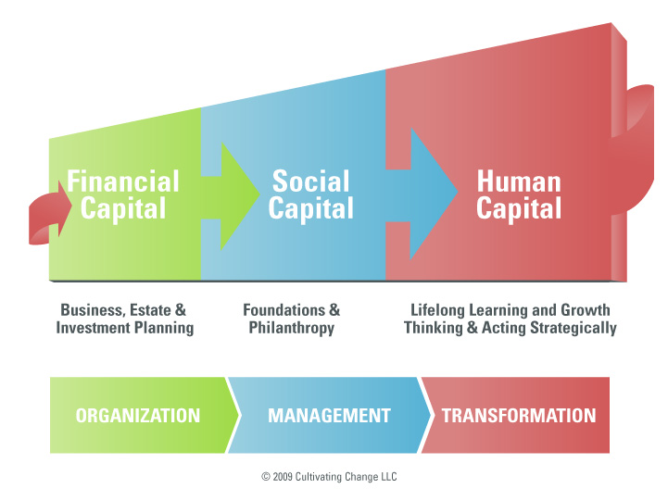
Capital: Social, Human, Financial
Financial Capital
  Economic resources (May differ greatly between large and small congregations)
Social Capital
  The church and relationships that shape interactions. It is the glue that hold churches together.
Human Capital
  The stock of knowledge, habits, social and personality attributes (creativity) embodied in a congregation.

Slide 8
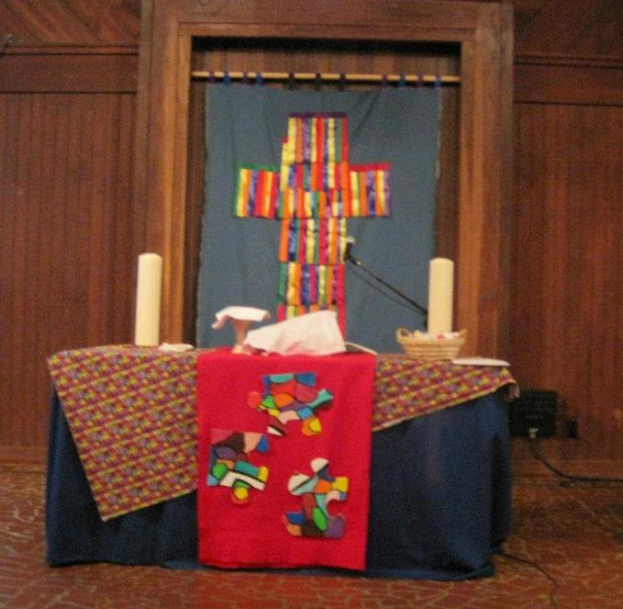
Conference Programs & Resources
Conference Youth Programs
Sam Halverson, Associate Director of Connectional Ministries for Youth & Young Adult Ministries
Conference Council on Youth Ministry
Confirmation Retreats & Resources
Connectional Mission Opportunities
Spiritual Life Retreats
Youth Ministry Institute (YMI)
Youth Service Fund (YSF)
Notes:
Sam Halverson
http://www.ngumc.org/newsdetail/814314
Conference Council on Youth Ministry
The CCYM is the group of youth and adult advisors who are responsible for the various youth ministries of the North Georgia Conference.
Confirmation Resources
The fall and spring Confirmation Retreats are designed for those young people who are learning more about what it means to follow Christ and to make a profession of faith. Each retreat will be a weekend of learning through a variety of educational experiences and presentations by leaders in the conference, inspiring worship, some fun and games, and times for the youth to reflect on their faith and their desire to follow Christ and join the United Methodist Church. There will be large group experiences as well as small group times. The Confirmation Retreats are designed primarily for 6th-8th graders, but can include senior high if they have not yet been confirmed. Some youth groups bring older youth as "student counselors" and that's fine if you structure your church's confirmation experience that way. - See more at: http://www.ngumc.org/confirmationresources#sthash.iUqVjScE.dpuf
Connectional Mission Opportunities
http://www.ngumc.org/missionexperiencesconnectedwiththeumc
http://www.ngumc.org/youthmissiontrip
The conference is hosting two trips for older youth to the Bahamas this summer.
Spiritual Life Retreats
Spiritual Life Retreats happen every spring in North Georgia. The three weekends are identical in content, though the bands and speakers change each weekend. Groups can register for any weekend and be assured of a quality retreat designed with the purpose of enriching the opportunities of spiritual growth for its participants. The retreats are designed and led by other youth and adult leaders in the conference, offering another level of leadership development to youth in the conference.
Youth Ministry Institute
YMI is an informational, practical, and relational annual training for folks who work in youth ministry.
http://www.ngumc.org/youthministryinstitute#sthash.KlOYRNA2.dpuf
Youth Service Fund
Youth Service Fund is a fund raised by youth, administered by youth, to support youth. 70% goes to ministries which serve youth inside (1/2) and outside (1/2) the geographic bounds of the North Georgia Conference. These grants are awarded by the Conference Council on Youth Ministries.30% goes directly to The United Methodist Church's Division on Ministries with Young People to support ministries around the world which serve the needs of youth and children.

Slide 9



Conference Programs & Resources
Russell Davis, Associate Director of Connectional Ministries for Camp and Retreat Ministries
Experiential Leadership Institute
Glisson Camp & Retreat
Notes:
Russell Davis,
North Georgia Camp & Retreat Ministries offers a variety of camping and retreat ministry opportunities for members of the North Georgia Conference of the United Methodist Church and beyond. Dating back to the founding of Camp Glisson in 1925, programs and sites now include the Experiential Leadership Institute (ELI), Grow Day Camps, and Glisson Camp & Retreat Center. North Georgia Camp & Retreat Ministries will serve 5,000 a year by 2020.
ELI
The Experiential Leadership Institute (ELI) is a safe space for rising 11-12th graders to discover, practice and reflect on their emerging leadership skills in live ministry settings. The Experiential Leadership Institute (ELI) is a safe space for rising 11-12th graders to discover, practice and reflect on their emerging leadership skills in live ministry settings. ELI is based on core values of experiential learning, practice, Christian community and service. As a leadership development program, ELI is designed specifically for rising 11th-12th graders who are ready to be self-reflective and to accept responsibility for elementary-aged children, who want to make a difference in the lives of others in Christian service, and who will benefit from gaining leadership experience before leaving home for college. Just as summer camp is guided by the understanding that faith can only be grown as it is practiced, ELI believes that leadership cannot be nurtured without the opportunity to lead. So after a week of leadership theory and skills training (Leadership Week), each participant will serve one or more weeks as a Day Camp Counselor (Volunteer Weeks) putting newly acquired skills to practice in a dynamic ministry setting.
Glisson
Glisson is a ministry of the North Georgia Conference of the United Methodist Church that offers Summer Camp and year-round Retreat experiences in the forests surrounding Cane Creek Falls. Summer camping programs of Glisson, include Village Camp, Outpost and Sparrowwood.

Slide 10
Resources
NGUMC Conference Youth Website. www.ngumc.org/youth
Youth Ministry Institute http://www.ngumc.org/youthministryinstitute
NGUMC Experiential Leadership Institute http://www.ngumc.org/eli
Facebook page http://www.facebook.com/NGUMCyouth?sk=wall
Research documents from the Fuller Seminary http://stickyfaith.org/
Webinar recordings http://www.prcli.org/
Sam Halverson sam.halverson@ngumc.net
Printed Resources (Devo, 3 Smiple Rules, The Life Book)
Needs Survey (A Tool Using It)
Contact District Office
Notes:
Connectional Ministries
How do you find out about these programs.
District Office – Some may have a youth coordinator.

Slide 11

Youth Devotional
1 Timothy 4:11-12
Notes:
1 Timothy 4:11-12 Instruct us “Command and teach these things. Don’t let anyone look down on you because you are young, but set an example for the believers in speech, in life, in love, in faith and in purity.”
Paul had a close teaching Christian relationship with young Timothy calling him “my true son in the faith”. 1 Timothy Ch. 1, v. 2
In this scripture, Paul, is instructing Timothy on how to live and grow in the Christian life. He tells him of the attributes a young person must have if they are to exhibit characteristics of a true follower of Jesus Christ. He tells him just because he is young not to let anyone look down on him. Paul tells Timothy, as a youth in the faith, he must set an example to other believers in his speech, his lifestyle, in his love, in his faith and in his purity. Paul is laying out the all-encompassing Christ-centered duties for Timothy.
We too have Christ-centered duties to our youth. We are vital witnesses to them and they in turn are vital witnesses for the Kingdom of God to others. We must do everything in our power to assure their success in the faith. We do this by making sure they have all the tools of faith our churches can provide.
Let Us Pray
Lord, enable us to encourage our youth in the path that leads them to your treasure house of blessings. In Christ’s name we prayer for the strength and wisdom to continue to empower your youth that leads them to life eternal.
In Christ’s blessed Name we pray. Amen
Sing:
Lead us Lord, Lead us in Thy righteousness. Make Thy way plain before our face.

Slide 12
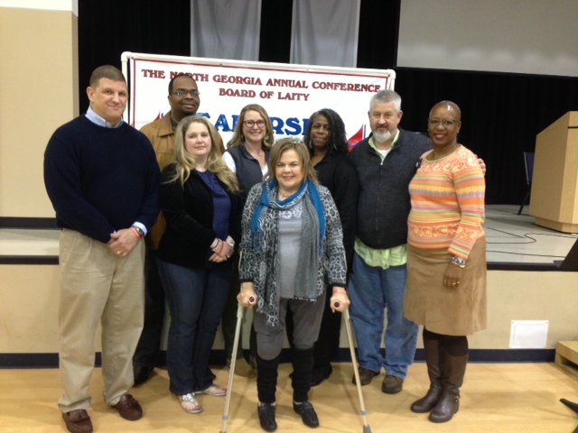
Thanks!
Questions?

